Slide 1
Topic 2 – Programming Revision

Slide 2
Programming language
We will need to use some programming language to represent data structures and algorithms
In this class, we will use the Java language
However, you could use any other programming language to encode the same ideas - another popular language is C++

Slide 3
Programming Languages
Languages are on a continuum from low-level electronics to high-level
At the lowest level the programming language provides no abstraction from the physical device
At the highest level the language is so abstract it is purely mathematical
Java is in the middle
Haskell
Lisp
Python
Ruby
Perl
Java
C#
C++
C
Assembly language
Electronic circuits

Slide 4
Java programming
Java is a programming language first released in 1995 originally developed by James Gosling at Sun Microsystems
One reason Java is popular is because it is platform independent
Programs written in Java can run on any hardware or operating-system
Compiled code is run on a Java Virtual Machine (JVM) which converts it to the native language

Slide 5
Platform independence
Turing showed that machine, software and input can all be represented in terms of patterns of information
The compiler translates the Java code into machine code that the JVM can run
JVM: Java Virtual Machine
The JVM is a machine simulated by the actual physical machine it is running on

Slide 6
The compilation process

Slide 7
Edit, compile, run
Compiling turns the code you wrote in Java (.java file) into a format that the computer can run on the JVM (.class file)
You can’t run your code without compiling it
Every time you change your code you need to recompile

Slide 8
Revision
We will now revise the following:
Variables & Data Types:
ints, doubles
Variable Operators:
addition, subtraction
Selection:
if, else
Iteration:
for, while, do

Slide 9
Variables
Variable is a name for a location in memory
2 types of variables
Primitive (e.g. int and double – usually smaller case letters)
Reference (e.g. objects – usually starts with capital letter)
Must have a type and a name
Cannot be a reserved word (public, void, static, int, …)
data type
variable name
int total;

Slide 10
Variables
A variable can be given an initial value in the declaration
int sum = 0;
int base = 32, max = 149;
When a variable is not initialized, the value of that variable is undefined

Slide 11
Scope & garbage collection
Variables defined within a member function are local to that function (this is referred to as the scope of a variable)
for (int i = 0; i < 50; i++){
…
}
Local variables are destroyed (garbage collected) when function exits (or goes out of scope.)
Programmer need not worry about de-allocating memory for out of scope objects/variables.
Unlike in C or C++
// The life time of variable i

Slide 12
Assignment
An assignment statement changes the value of a variable
The assignment operator is the = sign
total = 55;
The expression on the right is evaluated and the result is stored in the variable on the left
The value that was in total is overwritten
You can assign only a value to a variable that is consistent with the variable's declared type
assignment

Slide 13
Assignment
You can assign only a value to a variable that is consistent with the variable's declared type
int total;
int exam;
total = 55; // legal
exam = 90.5 // illegal: 90.5 is not an integer.
// assignment

Slide 14
Primitive types
There are exactly eight primitive data types in Java
Four of them represent integers:
byte, short, int, long
Example. 1, 11, 65536, -99
Two of them represent floating point numbers:
float, double
Example. 3.1416, 0.33
One of them represents characters:
char
Example. ‘set’, ‘A’
And one of them represents true/false boolean values:
Boolean

Slide 15
Bits and bytes
A single bit is a one or a zero, a true or a false, a "flag" which is on or off
A byte is made up of 8 bits like this : 10110001
1 Kilobyte = about 1,000 bytes (1,024 to be precise)
1 Megabyte = about 1,000,000 bytes (1,024 * 1,024)
1 Gigabyte = about 1,000,000,000 bytes

Slide 16
Primitive types
Type | Description | Size
int | The integer type, with range –2,147,483,648 . . . 2,147,483,647 | 4 bytes
byte | The type describing a single byte, with range –128 . . . 127 | 1 byte
short | The short integer type, with range –32768 . . . 32767 | 2 bytes
long | The long integer type, with range –9,223,372,036,854,775,808 . . . 9,223,372,036,854,775,807 | 8 bytes

Slide 17
Primitive types
Type | Description | Size
double | The double-precision floating-point type, with a range of about ±10308 and about 15 significant decimal digits | 8 bytes
float | The single-precision floating-point type, with a range of about ±1038 and about 7 significant decimal digits | 4 bytes
char | The character type, representing code units in the Unicode encoding scheme | 2 bytes
boolean | The type with the two truth values false and true | 1 bit

Slide 18
Number types
Illegal to assign a floating-point expression to an integer variable
double balance = 13.75;
int dollars = balance; // Error
Casts: used to convert a value to a different type
int dollars = (int) balance; // OK
Math.round converts a floating-point number to nearest integer
long rounded = Math.round(balance);
// if balance is 13.75, then rounded is set to 14
Example.
long rounded = Math.round(-3.7);
long rounded = Math.round(-4.2);

Slide 19
Examples of Math.round()
Math.round converts a floating-point number to nearest integer
Math.round( 11.5) = 12
Math.round(-11.5) = -11
Math.round( 11.46) = 11
Math.round(-11.46) = -11
Math.round( 11.68) = 12
Math.round(-11.68) = -12

Slide 20
Arithmetic expressions
Arithmetic expressions compute numeric results and make use of the arithmetic operators:
If either or both operands associated with an arithmetic operator are floating point, the result is a floating point
 | operator
Addition | +
Subtraction | -
Multiplication | *
Division | /
Remainder | %

Slide 21
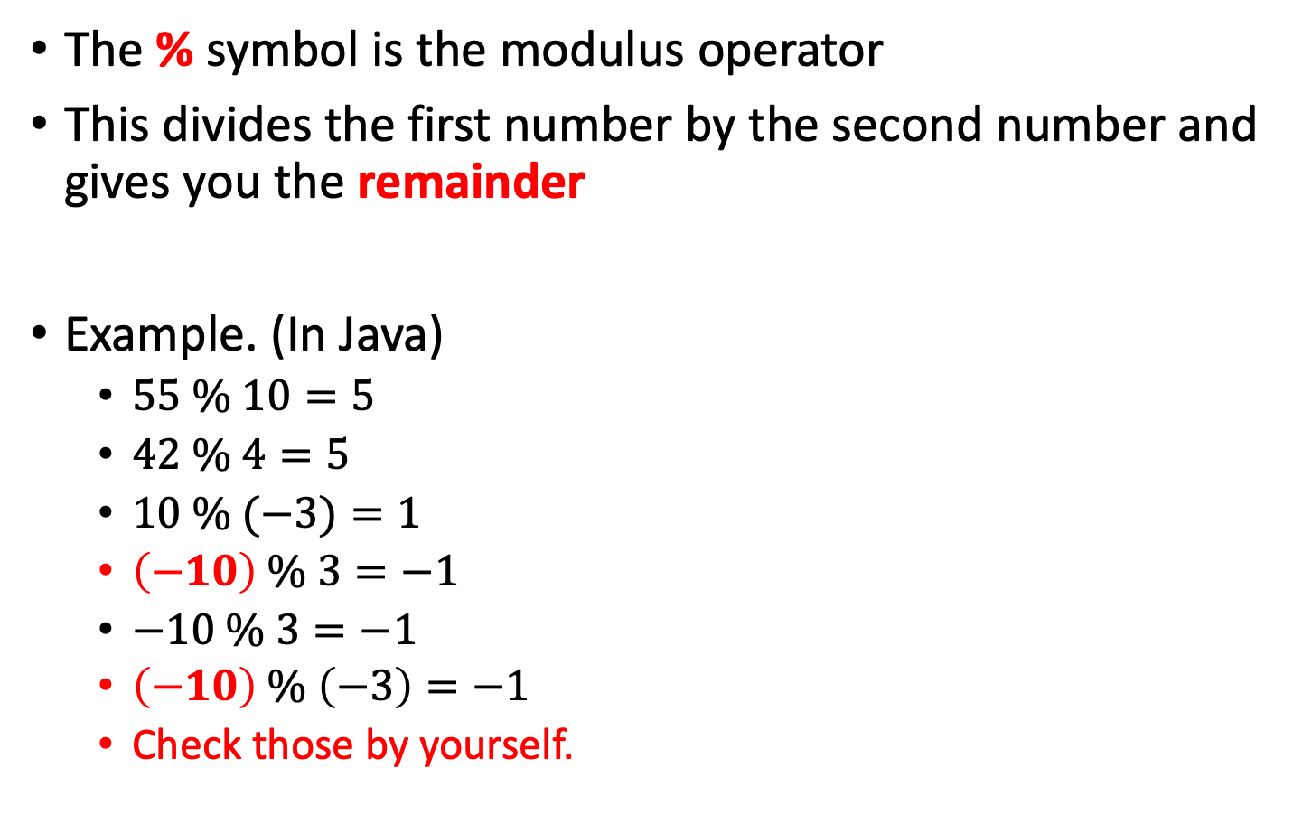
Modulus operator %
The % symbol is the modulus operator
This divides the first number by the second number and gives you the remainder
Example. (In Java)
$55 \% 10=5$
$42 \% 4=5$
$10 \% (−3)=1$
$\left(−10\right) \% 3=−1$
$−10 \% 3=−1$
$\left(−10\right) \% \left(−3\right)=−1$
Check those by yourself.

Slide 22
Answer
Both of these work
How can we figure out how many times 7 divides into a variable called number?
(number - (number % 7) )/ 7
number / 7 – ((number / 7) % 1)

Slide 23
Operator precedence
Operators can be combined into complex expressions
result = total + count / max - offset;
Multiplication, division, and remainder are evaluated prior to addition, subtraction, and string concatenation (BOMDAS rule)
Arithmetic operators with the same precedence are evaluated from left to right
Parentheses can be used to force the evaluation order

Slide 24
Increment and decrement
The increment and decrement operators are arithmetic and operate on one operand
The increment operator (++) adds one to its operand
The decrement operator (--) subtracts one from its operand
The statement
count++;
is functionally equivalent to count = count + 1;
count++; ⬅➔ count = count + 1;
count--; ⬅➔ count = count - 1;

Slide 25
Assignment operators
Often we perform an operation on a variable, and then store the result back into that variable
Java provides assignment operators to simplify that process
For example, the statement
num += count;
is equivalent to
num = num + count;
num += count; ⬅➔ num = num + count;
num -= count; ⬅➔ num = num - count;

Slide 26
Homework
Compare the different between
i++ and ++i
i-- and --i
If we set
int x;
int i = 5;
When we run the following codes, please show the value of x and the value of i.
Code 1: x = i++;
Code 2: x = ++i;

Slide 27
Homework
Due in class next week
Please write on a piece of A4 paper with a pen, and write your name and student number

Slide 28
Relational operators
operator |  | Example. a = 5, b = 5, c = 6
> | greater than | a > b // false c > b // true
>= | greater than or equal to | a >= b // true b >= c // false
< | less than | a < b // false b < c // true
<= | less than or equal to | a <= b // true c <= b // false
== | equal to | a == b // true b == c // false
!= | not equal to | a != b // false b != c // true

Slide 29
Frequent mistake!!
If we want to put the variable “number” equal to ten we use one equals sign
number = 10;
However, if we want to check if number is equal to ten then we use a double equals
if (number == 10) //OK
What happen if we write “if (number = 10)”?
Homework…

Slide 30
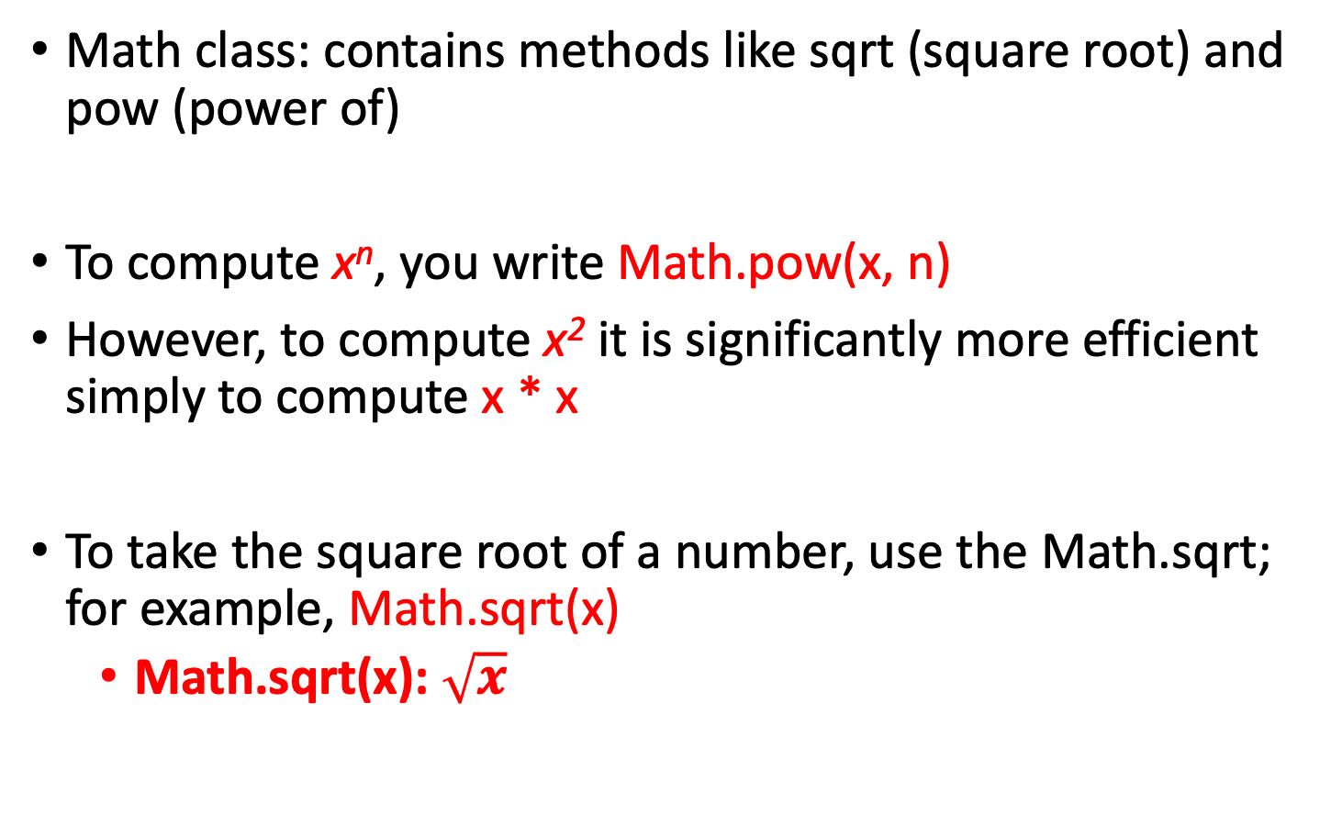
The Math class
Math class: contains methods like sqrt (square root) and pow (power of)
To compute x^{n}, you write Math.pow(x, n)
However, to compute x² it is significantly more efficient simply to compute x * x
To take the square root of a number, use the Math.sqrt; for example, Math.sqrt(x)
Math.sqrt(x): $\sqrt{x}$

Slide 31
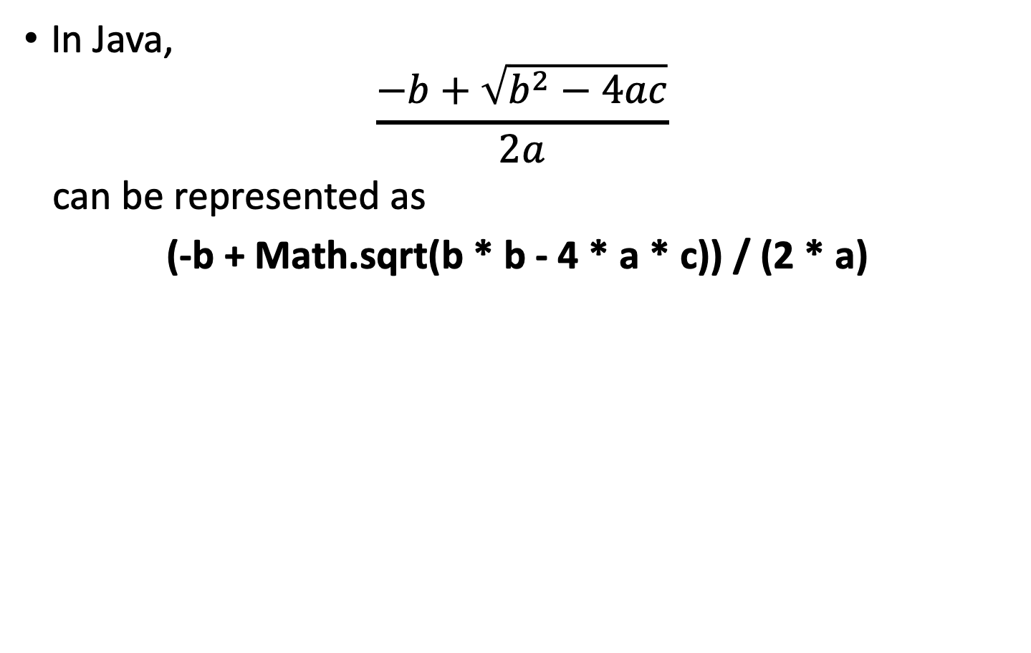
The Math class
In Java,
$$\frac{−b+\sqrt{b^{2}−4ac}}{2a}$$
can be represented as
(-b + Math.sqrt(b * b - 4 * a * c)) / (2 * a)

Slide 32
Mathematical methods in Java
Function | Result
Math.sqrt(x) | square root
Math.pow(x, y) | power x^{y}
Math.exp(x) | e^{x}
Math.log(x) | natural log
Math.sin(x), Math.cos(x), Math.tan(x) | sine, cosine, tangent (x in radian)
Math.round(x) | closest integer to x
Math.min(x, y) Math.max(x, y) | minimum, maximum

Slide 33
Mathematical methods in Java
Function | Example
Math.sqrt(x) | Math.sqrt(100) ⬅➔ 10
Math.pow(x, y) | Math.pow(10, 3) ⬅➔ 1000
Math.exp(x) | Math.exp(3) ⬅➔ e³
Math.log(x) | Math.log(-1); // NaN, out of range Math.log(0); // -Infinity Math.log(1); // 0 Math.log(10); // 2.302585092994046
Math.sin(x), Math.cos(x), Math.tan(x) | Math.sin(0); // 0 Math.sin(1); // 0.8414709848078965 Math.sin(Math.PI / 2); // 1
Math.round(x) | Math.round(20.3) ⬅➔ 20 Math.round(-20.5) ⬅➔ -20 Math.round(-20.51) ⬅➔ -21
Math.min(x, y) Math.max(x, y) | Math.min(5, 3) ⬅➔ 3 Math.max(5, 3) ⬅➔ 5

Slide 34
Questions
What is the value of 643 / 100?
Depends on whether double or int
Homework. Show the answer.
What is the value of 643 % 100?
43
Why doesn't the following statement compute the average of s1, s2, and s3?
Missing brackets
double average = s1 + s2 + s3 / 3; // Error

Slide 35
Strings
A string is a sequence of characters
Strings are objects of the String class
String variables:
String message = "Hello, World!";
String length:
int n = message.length();
Empty string:
""
Example.
EMPTY_STRING = "";

Slide 36
Concatenation
Use the + operator:
String name = "Dave";
String message = "Hello, " + name;
// message is "Hello, Dave"
If one of the arguments of the + operator is a string, the other is converted to a string
String a = "Agent";
int n = 7;
String bond = a + n; // bond is Agent7

Slide 37
Concatenation when printing
Useful to reduce the number of System.out.print instructions
System.out.print("The total is ");
System.out.println(total);
versus
System.out.println("The total is " + total);

Slide 38
Converting between Strings and numbers
Convert to number:
int n = Integer.parseInt(str);
double x = Double.parseDouble(str);
Example.
a = Integer.parseInt(“123”); ⬅➔ a = 123;
Convert to string:
String str = "" + n;
str = Integer.toString(n);
Example.
a = Integer.toString(123); ⬅➔ a = “123”;

Slide 39
Substrings
String greeting = "Hello, World!";
String sub = greeting.substring(0, 5); // sub is "Hello”
Supply start and stopping index
First position is at 0
stop
String Positions | 0 | 1 | 2 | 3 | 4 | 5 | 6 | 7 | 8 | 9 | 10 | 11 | 12
greeting | H | e | l | l | o | , |  | W | o | r | l | d | !
greeting.substring(0, 5)

Slide 40
Substrings
String greeting = "Hello, World!";
Syntax is (start index, stopping index)
greeting.substring(start index, stopping index)
Stops before it gets to the stopping index
Substring length is ‘ending index – stopping index’
greeting.substring(7, 12)
String Positions | 0 | 1 | 2 | 3 | 4 | 5 | 6 | 7 | 8 | 9 | 10 | 11 | 12
greeting | H | e | l | l | o | , |  | W | o | r | l | d | !
stop
greeting.substring(7, 12)
stop

Slide 41
Questions
Assuming the String variable s holds the value “Hello", what is the effect of the assignment s = s + s.length()?
s = “Hello”;
Assuming the String variable college holds the value "Maynooth", what is the value of college.substring(1, 2)?
college = "Maynooth”;
How about college.substring(2, college.length() - 3)?

Slide 42
Answer of Question 1
Assuming the String variable s holds the value “Hello", what is the effect of the assignment s = s + s.length()?
s = “Hello”;
We have that s.length() is 5.
Then s + s.length() is “Hello5”.
That is
s is set to the string “Hello5”

Slide 43
Answer of Question 2
Assuming the String variable college holds the value "Maynooth", what is the value of college.substring(1, 2)?
college = "Maynooth”;
We have that
college.substring(1, 2) is the string “a”

Slide 44
Answer of Question 3
How about college.substring(2, college.length() - 3)?
college = "Maynooth”;
We have that college.length() is 8.
Then college.substring(2, college.length() - 3) is
college.substring(2, 5)
Thus,
college.substring(2, 5) is set to the string “yno”

Slide 45
charAt( )
Another handy method that comes with Strings is charAt( )
This allows us to pick out characters at particular locations in the string
The first character has position 0
String s = “hello”;
System.out.println(s.charAt(0));
-----------------------------------------------
h
Is s.charAt(n) equal to s.substring(n, n+1)?

Slide 46
Summary of your homework
Homework 1.
If we set
int x;
int i = 5;
When we run the following codes, please show the value of x and the value of i.
Code 1: x = i++;
Code 2: x = ++i;
Homework 2.
Show me
int a = (int) 643 / 100;
double b = (double) 643 / 100;

Slide 47
Summary of your homework
Homework 3.
If s = “DataStructure”
Is s.charAt(n) equal to s.substring(n, n+1)?
What happen if we set s.substring(7, 11)?
What happen if we set s.substring(12, 13)?
Deadline of this homework is due in class next week
You must handwrite your homework on a piece of A4 paper, and write your name and student number on each A4 paper
I don't accept printed documents and electronic files

Slide 48
Comparing Strings
Strings are not numbers!!!
To test whether two strings are equal you must use a method called equals:
if (string1.equals(string2)) …
Do not use the == operator to compare strings.
if (string1 == string2)
The above tests to see if two string variables refer to the same string object – not the same as comparing values

Slide 49
More String comparisons
The compareTo Method compares strings in dictionary order:
If s1.compareTo(s2) < 0 then the string s1 comes before the string s2 in the dictionary
What do the following tell us?
s1.compareTo(s2) == 0
s1.compareTo(s2) > 0

Slide 50
More String comparisons
public class MyTest {
public static void main(String[] args) {
String str1 = "abc";
String str2 = "IloveU";
System.out.println(str1.compareTo(str2));
}
}
Output: 24
The ASCII code of ‘a’ is 97 and the ASCII code of ‘I’ is 73.
So str1.compareTo(str2) return 97 - 73 = 24.

Slide 51
More String comparisons
public class MyTest {
public static void main(String[] args) {
String str1 = "aIloveU520";
String str2 = "abc";
System.out.println(str1.compareTo(str2));
}
}
Output: -25
The ASCII code of ‘I’ is 73 and the ASCII code of ‘b’ is 98.
So str1.compareTo(str2) return 73 - 98 = -25.

Slide 52
More String comparisons
public class MyTest {
public static void main(String[] args) {
String str1 = "ljj";
String str2 = "ljjLovexql";
System.out.println(str1.compareTo(str2));
}
}
Output: -7
string str1 == string ste2.substring(0, str1.length() )
So str1.compareTo(str2) return the difference of their length
3 - 10 = -7.

Slide 53
More String comparisons
s1.compareTo(s2) < 0
the string s1 comes before the string s2 in the dictionary
Example. s1 = ‘abc’ and s2 = ‘af’
s1.compareTo(s2) == 0
the string s1 is equal to the string s2
s1.compareTo(s2) > 0
the string s1 comes after the string s2 in the dictionary
Example. s1 = ‘abc’ and s2 = ‘aac’

Slide 54
Reading input
System.in has minimal set of features – it can only read one byte at a time – not much use
Java 5.0, Scanner class was added to read keyboard input in a convenient manner
Scanner in = new Scanner(System.in);
System.out.print("Enter quantity: ");
int quantity = in.nextInt();

Slide 55
Reading input
nextInt reads a integer value
nextDouble reads a double value
nextLine reads a line (until user hits ENTER)
nextWord reads a word (until any white space)
You will need to include this line at the top:
import java.util.Scanner;

Slide 56
Reading input
public class Test{
public static void main(String[] args){
Scanner sc = new Scanner(System.in);
System.out.println(”Scanner test. Input a string: ");
while(ture){
String line = sc.nextLine(); // input
if (line.equals("exit")) break;
System.out.println(”>>> "+line); // output our input
}
}
}
// this code will end at here
Result:
============================
Scanner test. Input a string:
234 >>> 234 a test code >>> a test code exit

Slide 57
Sequence, selection, iteration
Almost all programming languages (e.g. Java, C, Pascal, C++, Cobol...) are based on 3 simple structures:
Sequence: lines separated by semicolon
;
Example.
int i;
i – 10;
Selection: if / else
Iteration: for/ while/ do
loops

Slide 58
Selection statements
A conditional statement lets us choose which statement will be executed next by using a conditional test
the if statement
the if-else statement
If-else if-else
Conditional test is an expression that results in a boolean value using relational operators
If we have the statement int x = 3, then the conditional test (x >= 2) evaluates to true

Slide 59
The if Statement
The if statement has the following syntax:
if (condition)
{
statement;
}
if is a Java reserved word
The condition must be a boolean expression.
That is its output is true or false.
It must evaluate to either true or false.
If the condition is true, the statement is executed. If it is false, the statement is skipped.

Slide 60
The if Statement
if (condition)
{
statement1;
statement2;
…
}
statement3;
// Condition is true:
// Do statement1, statement2, and keep on
// condition is false:
// Skip statement1, statement2, …
// Go to statement 3.

Slide 61
The if-else Statement
An else clause can be added to an if statement to make an if-else statement
if ( condition )
statement1;
else
statement2;
If the condition is true, statement1 is executed
If the condition is false, statement2 is executed
One or the other will be executed, but not both

Slide 62
The if-else Statement
public class Test {
public static void main(String args[]){
int score = 30;
if( score >= 60 ){
System.out.print(”You pass this course");
} else{
System.out.print("You didn't this course ");
}
}
}
Result:
============================
You pass this course

Slide 63
The if-else if-else Statement
if ( condition1 )
statement1;
else if ( condition2 )
statement2;
else
statement3;
If condition1 is true, statement1 is executed
If condition1 is false and condition2 is true, statement2 is executed
If both condition1 and condition2 are false, statement3 is executed
Only one statement will be executed.

Slide 64
Block statements
Several statements can be grouped together into a block statement
A block is delimited by braces : { … }
You can wrap as many statements as you like into a block statement

Slide 65
Block statement example
if (guess == answer) {
System.out.println(“Number of right guesses” + correct);
correct++;
}
else {
System.out.println(“Number of wrong guesses” + wrong);
wrong++;
}
// block statement 1
// block statement 2

Slide 66
Nested if statements
The statement executed as a result of an if statement or else clause could be another if statement
These are called nested if statements
You need to use good indentation to keep track of them

Slide 67
Nested if example
if (guess.equals(answer)) {
if (answer.equals(“yes”)){
System.out.println(“Yes is correct!”);
}
else {
System.out.println(“No is correct!”);
}
}
else {
System.out.println(“You guessed wrong.”);
}

Slide 68
Multiway Selection: Else if
Sometime you want to select one option from several alternatives
if (conditon1)
statement1;
else if (condition2)
statement2;
else if (condition3)
statement3;
else
statement4;

Slide 69
Else if example
double numGrade = 83.6;
char letterGrade;
if (numberGrade >= 89.5) {
letterGrade = ‘A’;
} else if (numGrade >= 79.5) {
letterGrade = ‘B’;
} else if (numberGrade >= 69.5) {
letterGrade = ‘C’;
} else if (numGrade >= 59.5) {
letterGrade = ‘D’;
} else {
letterGrade = ‘F’;
}
System.out.println(“My grade is ” + numGrade + “, ” + letterGrade);
Result:
=====================
My grade is 83.6, B

Slide 70
Logical operators
Boolean expressions can use the following logical operators:
They all take boolean operands and produce boolean results
Logical NOT is a unary operator
Logical AND and logical OR are binary operators
Symbol | Logical
! | NOT
&& | AND
|| | OR

Slide 71
Logical NOT
If some boolean condition a is true, then !a is false; if a is false, then !a is true
Logical expressions can be shown using truth tables
a | !a
true | false
false | true

Slide 72
Logical AND and logical OR
The logical AND expression
a && b
is true if both a and b are true, and false otherwise
The logical OR expression
a || b
is true if a or b or both are true, and false otherwise

Slide 73
Truth tables
truth table shows the possible true/false combinations of the terms
Since && and || each have two operands, there are four possible combinations of conditions a and b
a | b | a && b | a || b
true | true | true | true
true | false | false | true
false | true | false | true
false | false | false | false

Slide 74
Logical operators
Conditions can use logical operators to form complex expressions
if ((total < MAX+5) && !found)
System.out.println ("Processing…");
Condition 1: ((total < MAX+5)
Condition 2: !found
Here, if we want to do System.out.println ("Processing…"), we need both condition 1 and condition 2 holds
Logical operators have precedence relationships among themselves and with other operators
relational and arithmetic operators are evaluated first
logical NOT is evaluated before AND & OR

Slide 75
Iteration
Repetition statements (a.k.a. loops) allow a statement to be executed multiple times
Like conditional statements, they are controlled by boolean expressions
Java has three kinds of repetition statements:
the while loop
the do loop
the for loop
The programmer should choose the right kind of loop for the situation

Slide 76
The while statement
The while statement has the following syntax:
while (condition)
statement;
while is a reserved word
If the condition is true, the statement is executed.
Then the condition is evaluated again.
The statement is executed repeatedly until the condition becomes false.

Slide 77
Logic of a while loop
Note that if the condition of a while statement is false initially, the statement is never executed
Therefore, the body of a while loop will execute zero or more times

Slide 78
while loop example
Example 1.
int LIMIT = 5;
int count = 1;
while (count <= LIMIT) {
System.out.println(count);
count += 1;
}
Example 2.
int count = 1;
while (true) {
System.out.println(count);
count += 1;
}
Result of
Example 1:
==========
1
2
3
4
5
Result of
Example 2:
==========
1
2
3
4
5
6
7
8
9
…
...

Slide 79
Infinite loops
The body of a while loop eventually must make the condition false
If not, it is an infinite loop, which will execute until the user interrupts the program
This is a common logical error
You should always double check to ensure that your loops will terminate normally

Slide 80
The do Statement
The do statement has the following syntax:
do{
statement;
} while (condition);
do and while are reserved words
The statement is executed once initially, and then the condition is evaluated
The statement is executed repeatedly until the condition becomes false

Slide 81
do-while example
Example 1.
final int LIMIT = 5;
int count = 1;
do {
System.out.println(count);
count += 1;
} while (count <= LIMIT);
Example 2.
int count = 1;
do {
System.out.println(count);
count += 1;
} while (count <= 0);
Result of
Example 1:
==========
1
2
3
4
5
Result of
Example 2:
==========
1

Slide 82
Comparing while and do
while loop
do loop

Slide 83
Nested loops
Similar to nested if statements, loops can be nested as well
For each step of the outer loop, the inner loop goes through its full set of iterations
do {
do {
} while (…);
while (…);
Don’t forget the semicolon after the while!!!
// do loop 1
// do loop 2

Slide 84
The for Statement
The for statement has the following syntax:
for (initialization; condition; increment)
statement;
for is reserved word
The initialization is executed once before the loop begins
The statement is executed until the condition becomes false
The increment portion is executed at the end of each iteration
The condition-statement-increment cycle is executed repeatedly

Slide 85
Example
for (int i = 0; i < 5; i++) {
System.out.println(“hello: ” + i);
}
Result
==========
hello: 0
hello: 1
hello: 2
hello: 3
hello: 4

Slide 86
Logic of a for loop

Slide 87
The for statement
Like a while loop, the condition of a for statement is tested prior to executing the loop body
Therefore, the body of a for loop will execute zero or more times
Example.
for (int i = 0; i < -1; i++) {
System.out.println(“hello: ” + i);
}
It is well suited for executing a loop a specific number of times that can be determined in advance

Slide 88
Example
final int LIMIT = 5;
for (int count = 1; count <= LIMIT; count++) {
System.out.println(count);
}
Result
==========
1
2
3
4
5

Slide 89
Choosing a loop structure
When you can’t determine how many times you want to execute the loop body, use a while statement or a do statement
If it might be zero or more times, use a while statement
if it will be at least once, use a do statement
If you can determine how many times you want to execute the loop body, use a for statement

